Slide 1
Howard cattle Rustler Cheer
Character
Honor
Empowerment
Excellence
Respect

Slide 2
What makes a Rustler Cheerleader?
Qualities Needed for Cheerleading:
The word cheer means to encourage, motivate, and spread happiness and joy. This is one of the primary focuses of Rustler CHEER.
A leader is a person that facilitates the success of others. They work hard, stay positive, and encourage others to do the same. This is also the focus of Rustler CHEER.
The purpose of the Rustler CHEER program is to promote school pride and unity and to lead the school in demonstrating spirit and support for our students and various academic and athletic teams. As motivational leaders, Rustler Cheerleaders will promote school spirit, communication, and publicity.
Hardworking student with good grades.
A great, positive attitude.
Commitment and dedication to your team.
Patience and persistence.
Confidence.
Athleticism and physical strength.
Sportsmanship.
Ability to follow rules and directions.

Slide 3
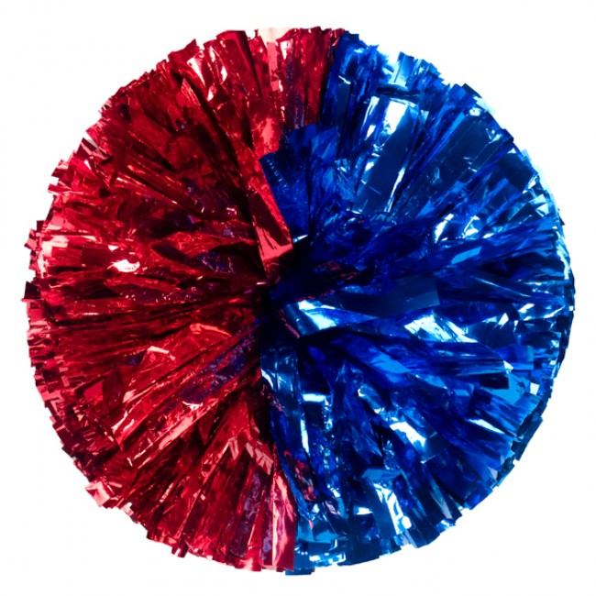
Yes, we will have fun too!
Rustler Cheerleaders will cheer, dance, and perform at various school and community events throughout the school year.
It is also our goal to participate in competitions.

Slide 4
Rustler cheer: One team schoolwide
Grades 3rd – 6th

Slide 5
Rustler cheer: Commitment & expectations
RUSTLER Cheerleaders are always expected to demonstrate excellent character and sportsmanship.
Rules, Regulations, and Guidelines
There is NO tolerance for any type of bullying (any issues must be brought to advisers/coaches immediately)
No profanity while in or out of uniform
No chewing gum while in uniform or during practice/events
There will be no eating while at practice or at events
Hair must be all pulled back if long enough to be in a ponytail
Only stud type earrings are acceptable, no necklaces, bracelets, or rings during practices and performances
No cell phone use during practice/events
No negative and/or bad attitudes
You will always treat coaches and team members with respect
Tardiness affects the entire team, be on time & available for the entire practice/event
Each Cheerleader is responsible to bring a water bottle to each practice/event
Maintain satisfactory grades, behavior, and attendance at school

Slide 6
Rustler cheer: Commitment & expectations
Practices:
Everyone must attend all practices. One person’s absence disrupts the entire squad
Practices will normally run on Tuesdays, from 11:30 – 1:00p.m. Advisors/Coaches will make the girls aware if any changes need to be made or if more practices are added to the schedule.
Cheerleaders/Parents/Guardians are expected to notify an advisor/ coach, IN ADVANCE (at least 24 hours),if they are to going to be tardy or miss a practice.
Failure to notify a coach/cheer advisor re: an absence will result in an “unexcused absence.” If a Cheerleader has 3 “unexcused absences” in a trimester they will be subject to removal from the team.
Any Cheerleader who has 3 or more absences in one trimester will be subject to removal from the team.

Slide 7
Rustler cheer: Commitment & expectations
Rallies (Tuesdays)/Performances/Special Events/Competitions (Pre-determined)
Cheerleaders must be dressed in full uniform for every Rally/Performances/Special Event.
Rustlers Cheer Dress – Cheerleaders will be notified when they need to wear their V-neck half shirt.
Royal Blue cheer briefs – worn under dress at all times.
WHITE socks only
All WHITE shoes
Hair pulled back
In colder weather ONLY BLACK or WHITE long sleeves and/or leggings are to be worn under the uniform. Rustler Spirit wear may be worn over tops if the weather is cold. Undergarments must be worn underneath the uniform.
Arrive to all rallies/performances/special events 20-40 min. prior.
Cheerleaders are responsible for bringing appropriate equipment to all rallies/performances/special events.
You are required to sit with team during performances and special events.
If a Cheerleader is late to practice and/or rally/performance/special event more than 3 times a trimester they will not be allowed to participate in any rallies/performances/special events for the remainder of that trimester
If a Cheerleader is late more than 3 times for 2 consecutive trimesters, they will be removed from the squad for the remainder of the school year.

Slide 8
Rustler cheer: Commitment & expectations – In Conclusion
Cheerleaders are expected to embody the school-wide PBIS expectations of being safe, being respectful, and being responsible!
Being a member or Rustlers CHEER is a privilege, not a right.
Students can and will be removed from CHEER based on their behavior, their grades, and lack of homework completion.
The administrative team and the Rustlers CHEER advisory panel have the right to remove students from the Rustlers CHEER team if members are not meeting academic and behavior expectations.
Periodic grade and attendance checks will be implemented.

Slide 9
Rustler cheer: Parent Agreement
Parent Agreement:
Parent agrees to sign up for the Rustler Cheer BAND App for the 2025-2026 Cheer Season.
The Rustler Cheer Band APP will be the primary form of communication re: team reminders, practice/performance reminders, changes to the practice schedule, and any additional updates for the 2025-2026 Rustler Cheer Season.
Parents agree to purchase Rustler Cheer Team Shirt, White V-Neck Long Sleeve, Royal Blue Shorts, Red Megaphone Socks, White Cheer shoes, and team bow. * If cost is an issue, please contact Cheer Advisor: Mrs. Garrison.
Parents agree to sign District Form 1465 and assume transportation responsibility to all performances/events.

Slide 10
Rustler cheer: tryouts
Cheer tryouts for the 2025-26 school year will be held on campus, after school on Friday, April 25th at 2:45 pm
To be eligible to try-out a student must:
Be a 3rd- 6th grade student attending Howard Cattle Elementary during the 2025-2026 school year.
Have and maintain good grades.
No suspensions or major behavior infractions.
Complete and Submit the following documents: Permission Slip for Rustler Cheer 2025-2026 Tryouts, Teacher Evaluation (Current Teacher), Attendance Form (submit to Miss Lucia at the front office), Howard Cattle Rustlers Cheer 2025-2026 Season Contract. Tryout Packet available Monday, April 14th at the front office.
Have a great attitude and be willing to work hard!!!!
Try-Out & Clinic Uniform:
Red, Blue or White T-Shirt (no logos if possible)
Shorts (blue or black) or leggings (blue or black) – No jeans
Sneakers/athletic shoes (no sandals, crocs, ankle booties, vans or slip-ons of any kind)
Hair securely pulled away from the face (high or low ponytail, braid, bun)- Bow recommended but not required
Try-Out Clinic will be held on: Tuesday, April 22nd at 11:30 – 1:30 pm
Notification of tryout results will be posted on the Howard Cattle School website by Friday, May 2, 2025.

Slide 11
Rustler cheer: tryout Clinic
Cheer Tryout Clinic for the 2025-26 school year will be held on campus, after school on Tuesday, April 22nd at 11:30 – 1:30 pm
Try-Out Clinic:
Coach Carissa will teach students a Tryout Cheer & Dance Routine. This Cheer and Dance Routine will be performed at Tryouts for a panel of judges.
Students do not need to attend the Tryout Clinic to be eligible to tryout for Rustler Cheer 2025-2026, however, it is HIGHLY Recommended that any student wanting to tryout for Rustler Cheer 2025-2026 attend the clinic to learn the Tryout Cheer & Dance Routine.
A video of the Tryout Cheer & Dance Routine will be posted on the Howard Cattle Website after the Tryout Clinic for students to practice for tryouts.

Slide 12
Rustler cheer: tryouts
Cheer tryouts for the 2025-26 school year will be held on campus, after school on Friday, April 25th at 2:45 pm
Try-Outs:
Student will be given a tryout number.
Students will try out in random groups of 3-4 (depending on the number of students trying out for Rustler Cheer)
Students will perform the 2025-2026 Tryout Cheer & Dance Routine for a panel of Judges.
Tryouts are CLOSED- parents are not allowed to watch Tryouts.
Parents may wait for their student at the red lunch tables during tryouts. If a parent/guardian is unable to stay for the tryout process, the office will contact you once your student is done with tryouts and ready for pickup.
The 2025-2026 Rustler Cheer Team will be a squad of 18-20 members.

Slide 13
Rustler cheer: Uniform
Red & White Spirit Dress *
White Underliner (Half-top)
Royal Blue Briefs
Red & White Megaphone Socks
Half Top (Underliner)
White Cheer Shoes
Pom Poms *
Red Sparkle Hair Bow
All the above plus practice T-shirt and shorts
* On loan agreement with Howard Cattle Elementary

Slide 14
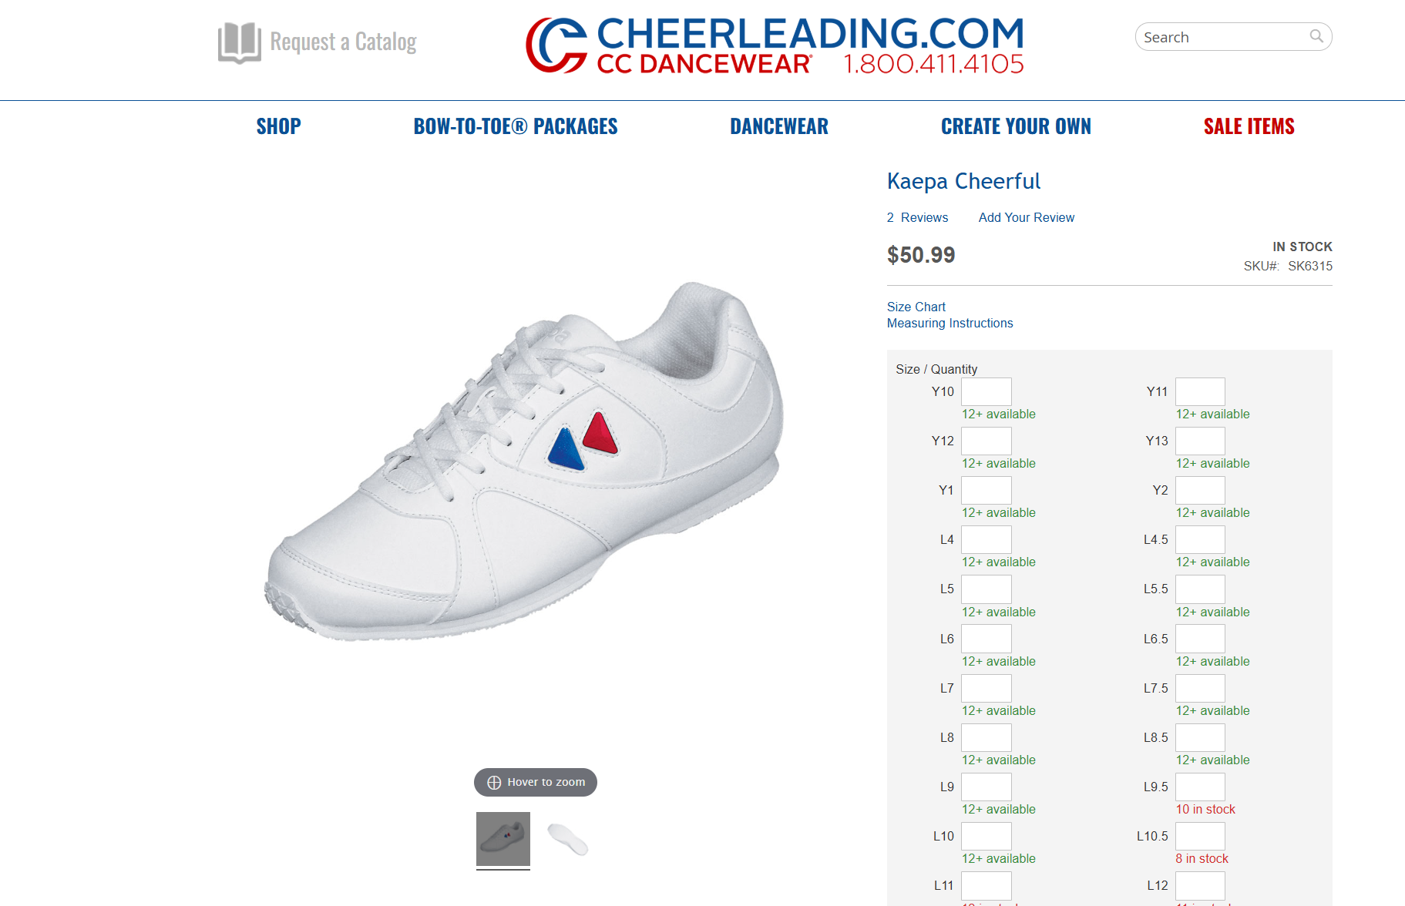
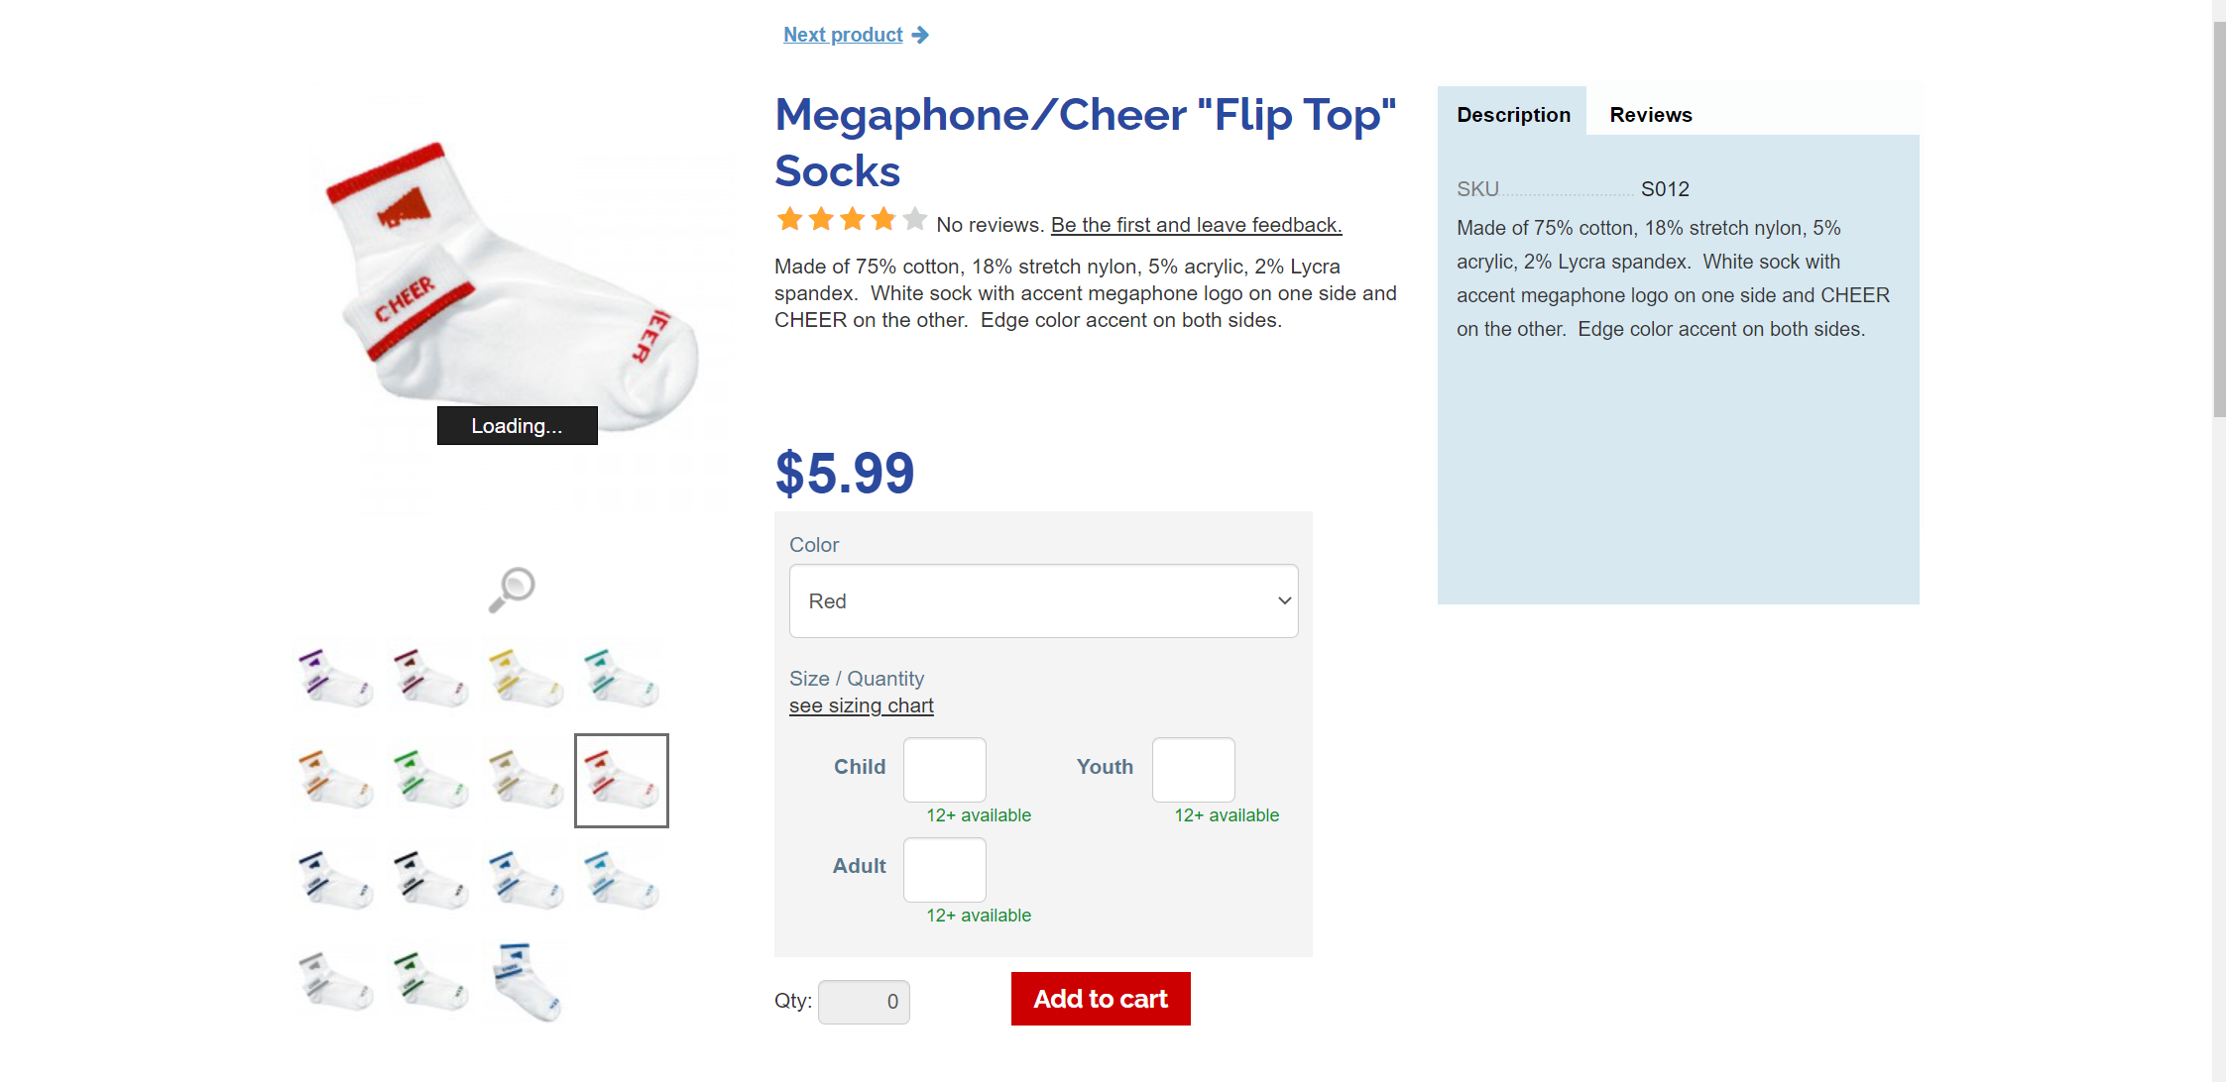
Rustler cheer: Uniform Options
Cheerleader Costs:
Shoes: approximately $55
Socks: approximately $6
Briefs: approximately $9
Long sleeve half top (underliner): approximately $17
Cheer Shirt for Camp & Practices: approximately $15-18
Cheer bow: approximately (practice) and $15-18 (show/competition)

Slide 15
Rustler Cheer: summer CAMP
There will be MANDATORY CHEER CAMP: June 2nd and 3rd for those that make the team.
Camp will be held at Howard Cattle Elementary School

Slide 16
Rustler cheer: Advisors
Howard Cattle Cheer Advisors:
Mrs. Meg Garrison – 2nd Grade Teacher
Mr. Buss – Principal
Cheer Coach – Carissa Rash
PFA Advisor – Adriana Dominguez-Jacobsen

Slide 17
Thank you
We appreciate your interest in the Howard Cattle Rustler CHEER program. If you want to proceed with the tryout process, please have your student complete a Tryout Packet. Tryout Packet’s will be available on Monday, April 14th at the front office.
If you have any questions, concerns, and/or comments please feel free to email Mrs. Garrison at meg_garrison@chino.k12.ca.us

